Slide 1

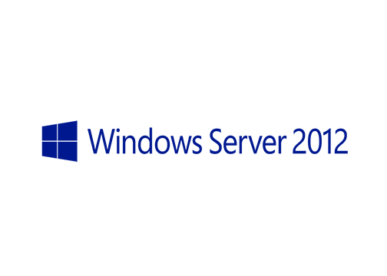
MegaSeries
Basic Hyper-V configuration with Powershell

Slide 2
Prerequisites
Have a server with the Hyper-V role installed already set up
Since Hyper-V cannot be officially installed on a virtual machine you have to use a workaround to do this: Install Hyper V on a Windows Server 2012 VM | QuickTip

Slide 3
What will be covered
Hyper-V host configuration
Virtual switch creation
Virtual machine creation
Virtual machine deletion
Setting different virtual machine settings
Create, assign and delete virtual disks

Slide 4
https://www.youtube.com/channel/UCcZ-jLbPwNr8E_v9-65n8Iw https://github.com/itknowledge4

